Slide 1
Jesus eats dinner with me My first Study Bible ~ Page 282
Matthew 9:9-13
Mark 2:14-17
Luke 5:-27-32

Slide 2
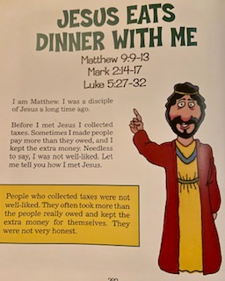
What does it mean to be honest?
Being honest is to tell the truth!

Slide 3
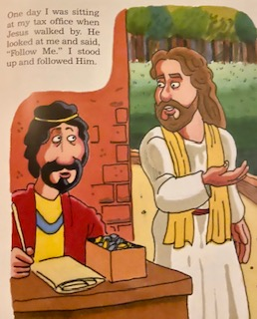
Follow Me

Slide 4
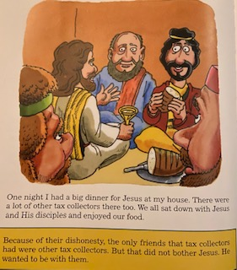
Look at the picture…
What do you see? What are they eating? wearing?

Slide 5
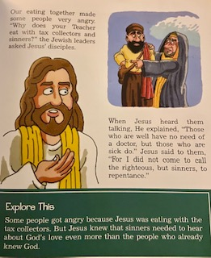
Why were the Jewish leaders angry?

Slide 6
For God did not send his Son into the world to judge the world, but to save the world through him.
John 3:17

